Slide 1

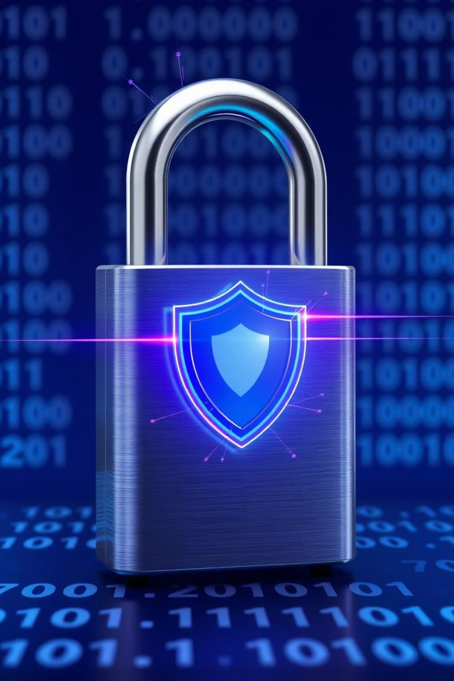
Phishing Awareness: Protect Yourself from Online Scams
Welcome to this session on phishing awareness. In today's connected world, it's vital to understand and spot online scams. This presentation will teach you how to recognize, avoid, and report phishing attacks and other tricks, keeping your digital information safe.
We will cover different types of attacks, from fake emails to clever social manipulation. You'll learn simple ways to protect yourself and our organization from bad actors. Your attention and caution are important for creating a safer online space for everyone.
By: Devam Shah
To: CodSoft
Cyber Security
Notes:
1

Slide 2
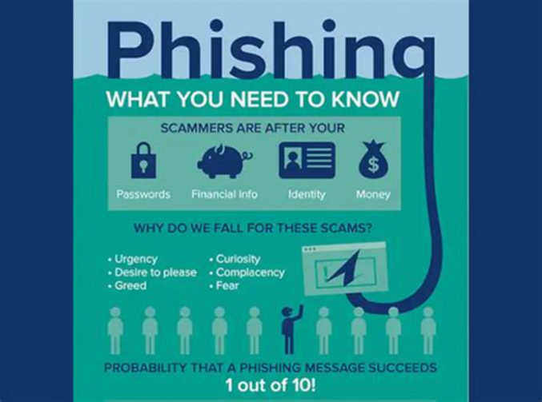
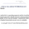



Introduction to Phishing
Phishing is a deceptive cyberattack where criminals impersonate trusted entities to trick individuals into revealing sensitive information (e.g., login credentials, financial details), leading to identity theft or fraud.
Phishing attacks are constantly evolving, becoming more sophisticated and harder to detect, ranging from malicious emails to fraudulent websites.
Recognizing key signs—suspicious email addresses, questionable URLs, and unsolicited requests for sensitive data—can significantly reduce vulnerability to these threats.
Types of Phishing Attacks
Email Phishing
Smishing (SMS Phishing)
Vishing (Voice Phishing)
Attackers use deceptive emails, often mimicking legitimate organizations, to trick recipients into revealing sensitive data or clicking malicious links.
Phishing attempts via text messages (SMS) with malicious links, designed to compromise devices or personal information.
Attacks via voice calls where impersonators (e.g., banks, government) trick recipients into revealing sensitive information.
Clone Phishing
Cybercriminals replicate legitimate, previously sent emails with malicious links or attachments to bypass security.
Notes:
2

Slide 3
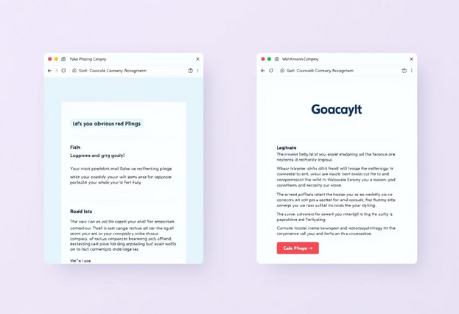





Recognizing Phishing Emails
Phishing emails often contain subtle clues that, once you know what to look for, become glaring red flags. Being vigilant and critically examining every suspicious email can save you from becoming a victim of these scams. Always take a moment to pause and scrutinize the message before taking any action.
Even legitimate companies can have typos, but a combination of several of these indicators should raise immediate suspicion. When in doubt, it's always best to err on the side of caution and verify through official channels.
Key Indicators of a Phishing Email
Urgent or Threatening Tone
Suspicious Sender Address
Generic Greetings
Messages demanding immediate action or threatening account closure often signal a scam. For example, "Your account will be locked if you don't respond now!"
Check the sender's email address. It might look similar but have slight variations, like amazon-support@mail.ru instead of the official domain.
Legitimate communications usually address you by name. Phishing emails often use "Dear User" or "Dear Customer."
Unusual Links or Attachments
Poor Grammar or Design
Hover over links to see the actual URL before clicking. Be wary of unexpected attachments, especially those with unusual file types.
Typos, grammatical errors, and inconsistent branding or low-quality logos are common indicators of a fraudulent email.
Notes:
3

Slide 4
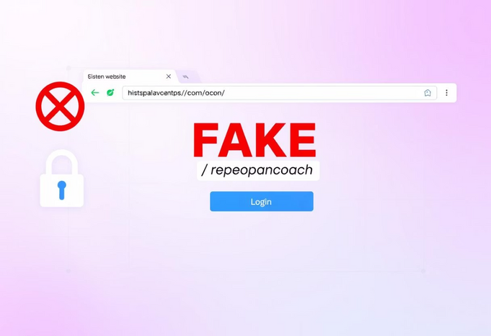
Spotting Fake Websites
Just as with emails, malicious actors create fake websites that mimic legitimate ones to steal your information. These sites are designed to look identical to trusted platforms, making it easy to fall into their trap. However, by paying close attention to specific details, you can identify these imposters and protect your data.
Always double-check the URL and look for security indicators before entering any personal information. Your diligence in these small steps can make a significant difference in preventing a successful phishing attempt.
Key Indicators of a Fake Website
Misspelled URLs
Lack of HTTPS
Carefully check the website address for subtle misspellings, like go0gle.com instead of google.com.
Legitimate sites, especially those requiring login or payment, use "https://" (secure connection) and display a padlock icon in the browser bar. If it's just "http://", be cautious.
Pop-ups Asking for Credentials
Unexpected Redirects
Be suspicious of unexpected pop-up windows requesting your login details. Legitimate sites rarely do this.
If clicking a link takes you to a completely different, unfamiliar website, close the tab immediately. This is a common tactic for phishing.
Tip: Always hover over links before clicking to see the actual destination URL. This allows you to inspect the link for suspicious activity without actually navigating to a potentially harmful site.
Notes:
4

Slide 5



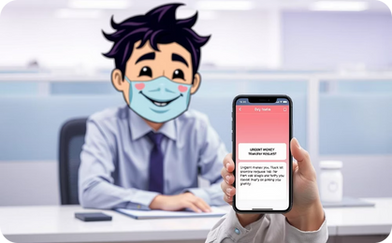
Social Engineering Tactics
Social engineering exploits human psychology rather than technical vulnerabilities. Attackers manipulate individuals into performing actions or divulging confidential information by leveraging trust, fear, or urgency. They often craft convincing scenarios to bypass security protocols, making it essential to be aware of their methods.
Understanding these tactics empowers you to recognize when someone is attempting to manipulate you, allowing you to react appropriately and protect sensitive data. Always question unsolicited requests for information, especially if they involve passwords or financial details.
Common Social Engineering Tactics
Pretexting
Baiting
Tailgating
Impersonation
Creating a fabricated scenario to trick a victim into divulging information, like impersonating IT support.
Luring victims with false promises or tempting offers, such as "free downloads" that hide malware.
Gaining unauthorized access to restricted areas by following closely behind an authorized person.
Posing as someone in authority or a trusted contact, such as a "CEO scam" requesting urgent money transfers.
"Hello, this is IT, I need your password to fix a security issue." This classic line is a red flag! Legitimate IT support will never ask for your password directly.
Notes:
5

Slide 6
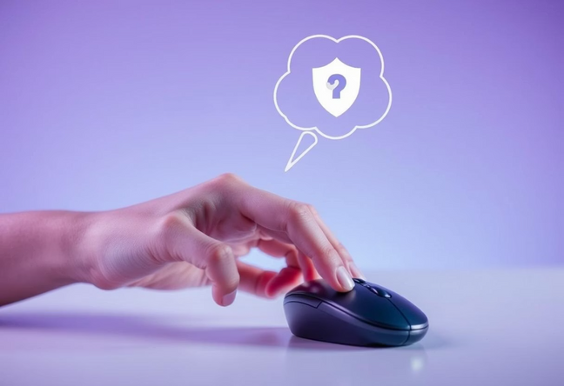
Best Practices to Avoid Phishing
Protecting yourself from phishing and social engineering requires a combination of awareness and proactive security habits. By integrating these best practices into your daily digital routine, you can significantly reduce your risk of falling victim to these pervasive threats. Cybersecurity is a shared responsibility, and by taking the necessary steps to safeguard your personal and organizational data, you play a crucial role in building a more secure online ecosystem.
The steps outlined in this section are simple yet incredibly effective. From scrutinizing email senders and URLs to maintaining a healthy skepticism towards unsolicited requests, these practices form the foundation of a robust defense against most online scams. Consistent application of these habits will empower you to navigate the digital landscape with greater confidence and vigilance, ultimately minimizing the impact of these persistent threats.
Remember, phishing and social engineering attacks are constantly evolving, and staying informed is key to maintaining a strong security posture. By regularly reviewing the latest trends and best practices, you can ensure that your defenses remain up-to-date and effective. Together, we can work towards a more secure digital future, where the risks posed by these deceptive tactics are significantly reduced.
Your Shield Against Online Scams
1
Think Before You Click!
Always pause and scrutinize emails, messages, and links. Does something feel off? Trust your instincts.
2
Verify with Official Sources
If a message seems urgent or suspicious, contact the organization directly using their official website or a known phone number, not the contact info provided in the suspicious message.
3
Use Multi-Factor Authentication (MFA)
Enable MFA whenever possible. This adds an extra layer of security, making it much harder for attackers to access your accounts even if they steal your password.
4
Report Suspicious Messages
If you receive a phishing attempt, report it immediately to our IT or security team. Your report helps protect everyone else.
5
Keep Software & Browsers Up to Date
Regularly update your operating system, web browsers, and all software. Updates often include critical security patches that protect against known vulnerabilities.
Notes:
6

Slide 7
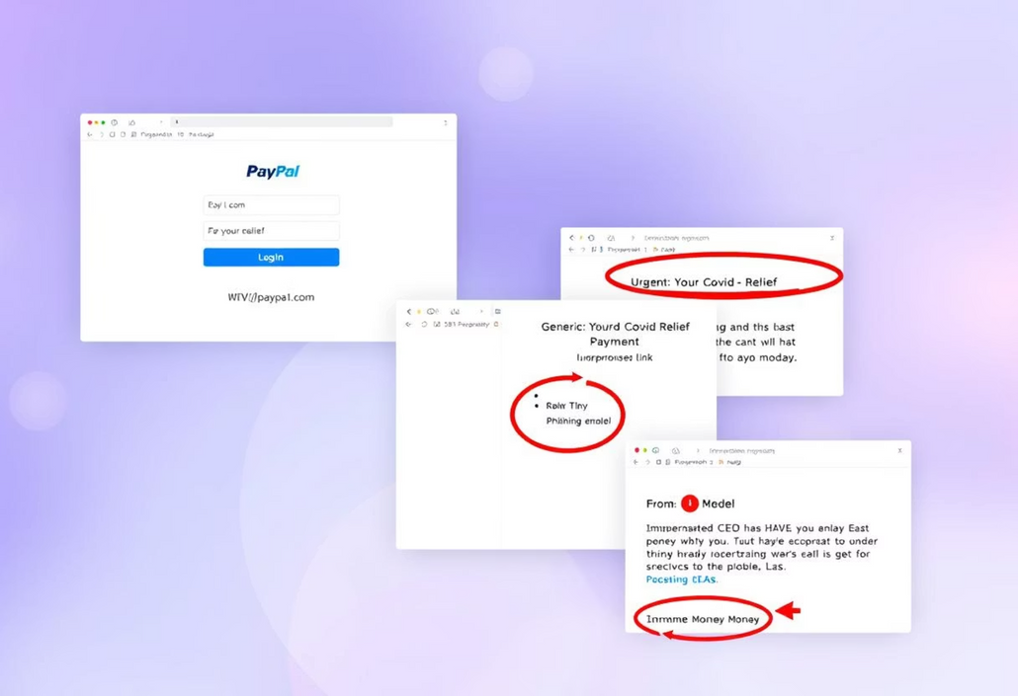
Real-World Examples of Phishing Attacks
Understanding real-world examples is crucial to grasping how these attacks unfold. Phishing attempts constantly evolve, adapting to current events and employing sophisticated social engineering techniques. By reviewing these specific cases, you can better prepare to recognize and avoid similar traps in the future.
These examples highlight the diverse and ever-evolving tactics that cybercriminals use to target unsuspecting victims. From financial scams designed to steal sensitive information to exploiting global crises for malicious gain, the methods employed by these bad actors continue to grow in sophistication.
What these varied phishing schemes all have in common, however, is a reliance on human psychology and a calculated effort to bypass our natural defenses. Scammers leverage social engineering, fear-mongering, and a false sense of urgency to coerce individuals into letting their guard down and falling for these deceptive schemes.
Vigilance and critical thinking remain your most powerful defenses against these manipulative tactics. By developing a keen eye for the red flags of phishing and cultivating healthy skepticism, you can protect yourself and your organization from the devastating consequences of these online scams.
Throughout this comprehensive deck on phishing awareness, we'll arm you with the knowledge and strategies needed to identify, avoid, and respond to a wide range of phishing attacks. With this essential training, you'll be better equipped to navigate the digital landscape and maintain the integrity of your personal and professional information.
CEO Fraud (Business Email Compromise)
Fake PayPal Alert
A high-level executive's email account was either compromised or spoofed. The attacker then sent urgent emails to employees (often in finance) requesting immediate wire transfers to external accounts, disguised as confidential business transactions. Millions of dollars have been lost to such scams.
Users received emails disguised as official PayPal alerts, falsely claiming unusual account activity. They were prompted to click a link to "reset their password," which led to a fraudulent login page designed to steal credentials.
1
2
3
COVID-19 Relief Fund Scam
During the pandemic, attackers sent emails impersonating government or health organizations, offering "COVID-19 relief funds" or "stimulus packages." These emails often contained malicious links or attachments that installed malware or requested personal financial details.
Notes:
7

Slide 8


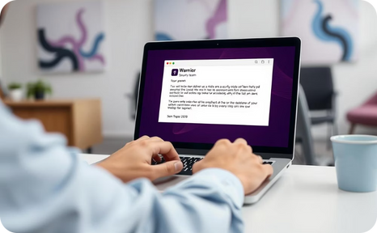
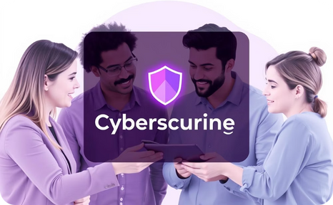
Reporting and Response
Reporting suspicious activities is very important for our group's online safety. When you find a possible phishing attempt or a security threat, your quick action can stop harm to yourself and the whole company. We have clear rules to make sure every possible issue is handled well and fast.
By always reporting and following these rules, you help keep our environment secure for everyone. Your carefulness is very valuable in our ongoing fight against online threats and in building a strong "Think Before You Click" habit.
Find the Threat
Don't Interact
Tell IT Right Away
Follow IT's Advice
Learn to spot signs of phishing emails, fake websites, or social engineering attempts using the tips discussed.
Do not click links, open attachments, or reply to suspicious messages. Never enter passwords on questionable websites.
Send suspicious emails as attachments to: security@yourorg.com. For calls or texts, record details and contact IT directly.
Our IT security team will investigate your report and provide next steps, if needed. Collaboration reduces potential risks.
Help Build a "Think Before You Click" Habit: Share what you know with coworkers. Sharing information helps us build a stronger defense against cyberattacks.
Notes:
8

Slide 9
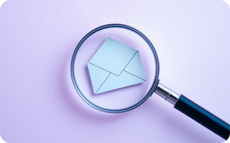

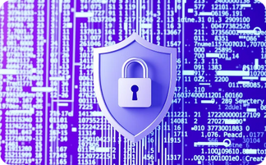
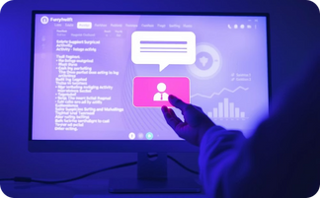
Conclusion & Resources
We've covered essential aspects of phishing awareness, from recognizing deceptive tactics to implementing best practices for prevention. Your ability to identify and respond to these evolving threats is a vital asset in safeguarding not only your personal information but also the collective integrity of our organizational data. Understanding the nuances of these attacks empowers us all to be the first line of defense.
Cybersecurity is an ongoing learning process that requires continuous adaptation. Stay curious about new threats, stay updated on the latest security measures, and consistently apply the principles discussed today. By fostering a proactive approach and sharing knowledge, you contribute significantly to building a safer, more resilient, and more secure digital environment for everyone in our community.
Key Takeaways
Be Vigilant
Practice Caution
Use Strong Defenses
Report All Suspicions
Always verify sender identity, scrutinize URLs, and check messages for inconsistencies or unusual requests. Your careful attention is crucial.
Never click suspicious links, open unexpected attachments, or provide personal information without independent verification. When in doubt, assume it's malicious.
Enable multi-factor authentication (MFA) on all accounts. Ensure all software, operating systems, and security applications are consistently updated.
Immediately report any perceived phishing attempts, suspicious emails, or security concerns to our IT security team. Prompt reporting protects the entire organization.
External Resources for Ongoing Awareness
phishing.org - A comprehensive resource for understanding various types of phishing attacks and staying safe online. Offers definitions, examples, and prevention tips.
staysafeonline.org - Provides practical tips and resources from the National Cyber Security Alliance to help individuals and businesses stay safe and secure online.
CISA.gov/US-CERT - The official website of the Cybersecurity and Infrastructure Security Agency, offering alerts, advisories, and tips on current cyber threats.
FBI.gov Internet Scams - Information from the Federal Bureau of Investigation on common internet scams and how to report them.
Remember, a strong cybersecurity posture is a shared responsibility. Your commitment to these practices directly contributes to a safer digital environment for all of us. Thank you for your continued diligence!
Notes:
9

Slide 10

Thank You!
Thank you for your valuable time and attention during this cybersecurity internship presentation on phishing awareness. Your commitment to understanding and applying these safety measures is crucial in strengthening our collective defense against cyber threats. Remember, a secure digital environment is a shared responsibility, and every individual plays a vital role.
We encourage you to continue exploring the resources provided and to remain vigilant in your online interactions. If you have any further questions or encounter anything suspicious, please do not hesitate to reach out to our IT security team. Stay safe, stay secure!
By: Devam Shah
To: CodSoft
Cyber Security
Notes:
10

